Slide 1
REACT NATIVE
Lesson 5: GraphQL Mutations

Slide 2

GraphQL
Mutations

Slide 3
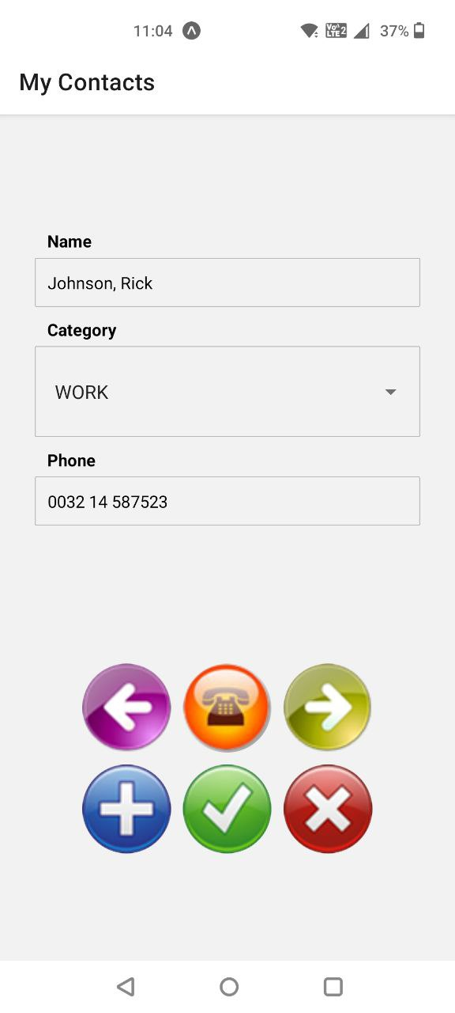
Our Goal

Slide 4
GraphQL
https://cloud.hasura.io/
Create contacts & categories
Notes:
mutation {
insert_contacts(objects: [
{name:"Jones, Jeff", category_id: 1, phone:"0032 14 263541"},
{name:"Smith, Olive", category_id: 3, phone:"0032 479 653214"},
{name:"Brown, Amelia", category_id: 8, phone:"0032 465 005202"},
{name:"Johnson, Rick", category_id: 3, phone:"0032 14 587523"},
{name:"Wilson, Bart", category_id: 1, phone:"0032 479 632541"},
]) {
affected_rows
}
}
mutation {
insert_categories(objects: [
{id: 1, name:"family"},
{id: 3, name:"work"},
{id: 8, name:"friends"}
]) {
affected_rows
}
}

Slide 5
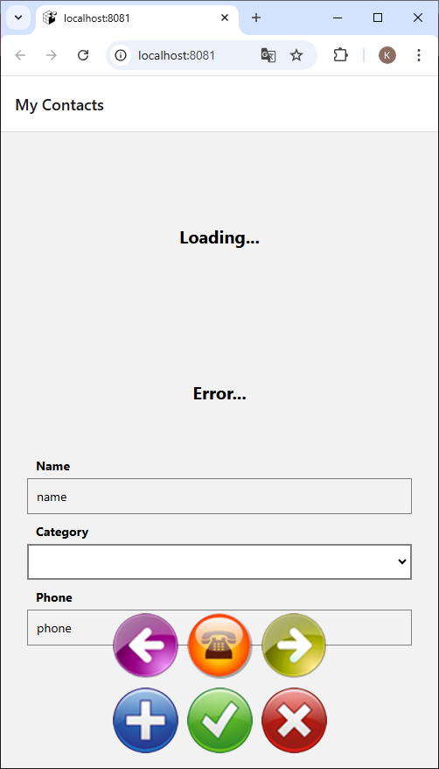
Contacts
npx create-expo-app@latest lesson5
npm run reset-project
npm install @apollo/client graphql
npm install react-native-phone-call
npm install @react-native-picker/picker
Delete index.tsx
Copy Resources
npx expo start

Slide 6
TODO

Slide 7
Exercise
Insert
Delete
Fix order problems after mutation

